Slide 1
Beer presentation
By: Leo Leal

Slide 2

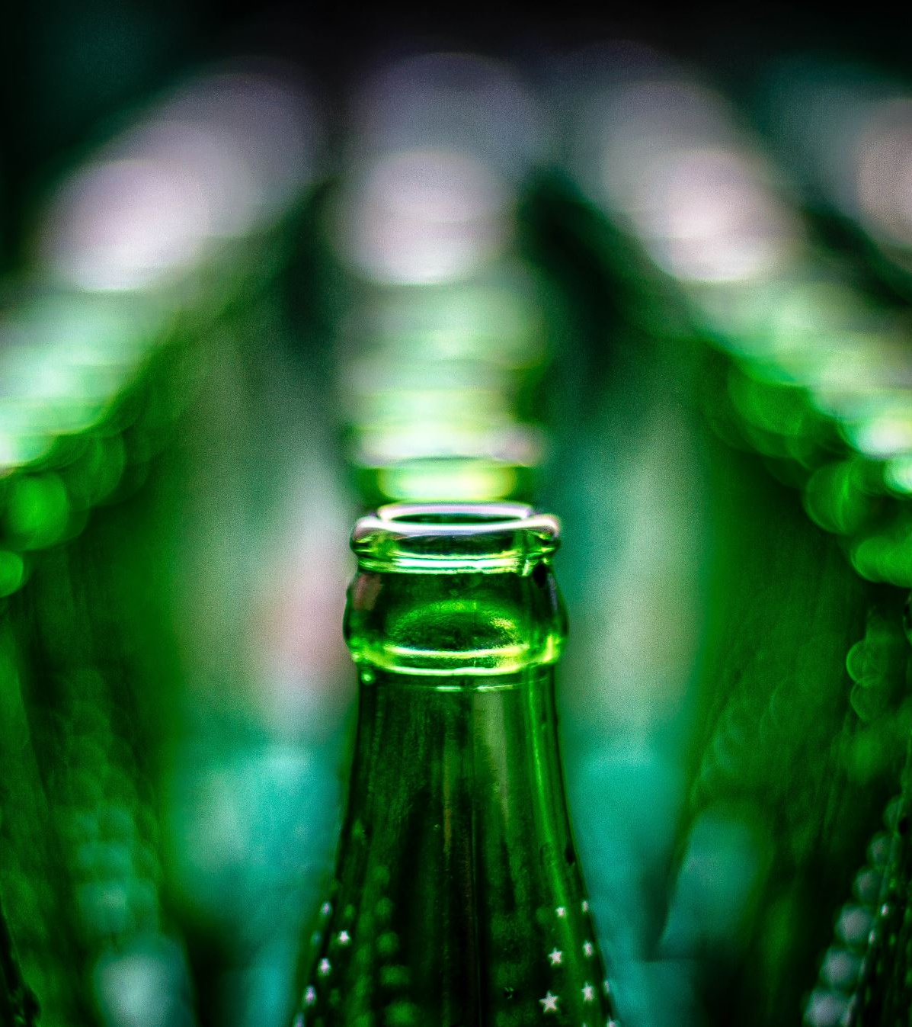
The data sets
There are 2 data sets that will be part of the study:
Breweries – Containing information on the breweries and where they are located.
Beers – Contain information about specific beers such as brewery that produced it, style of beer it is, ABV, and IBU.
N/A values in the ABV and IBU features filtered out.

Slide 3
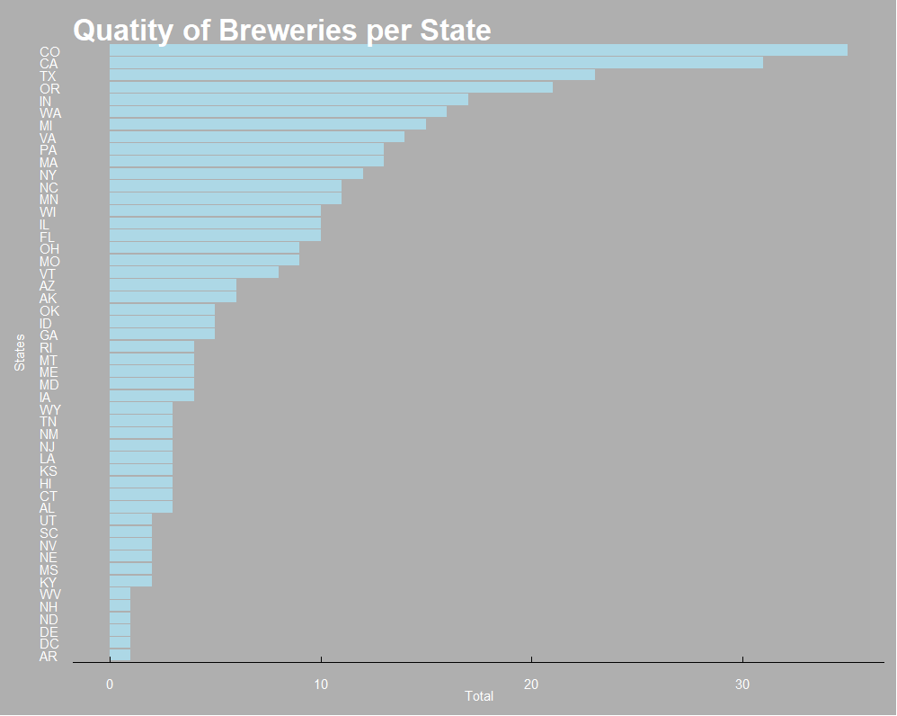

Slide 4
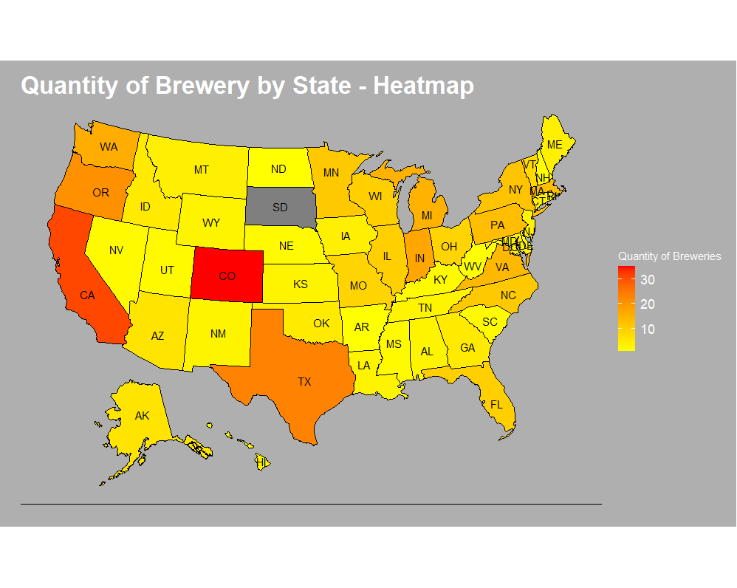

Slide 5
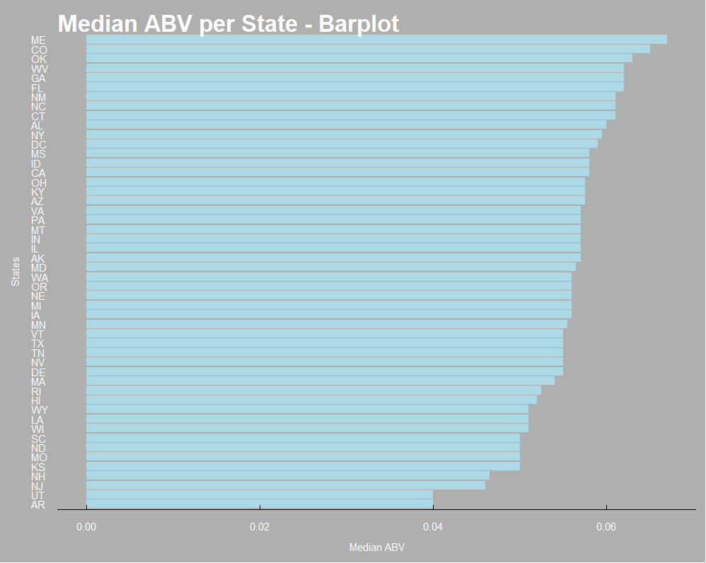
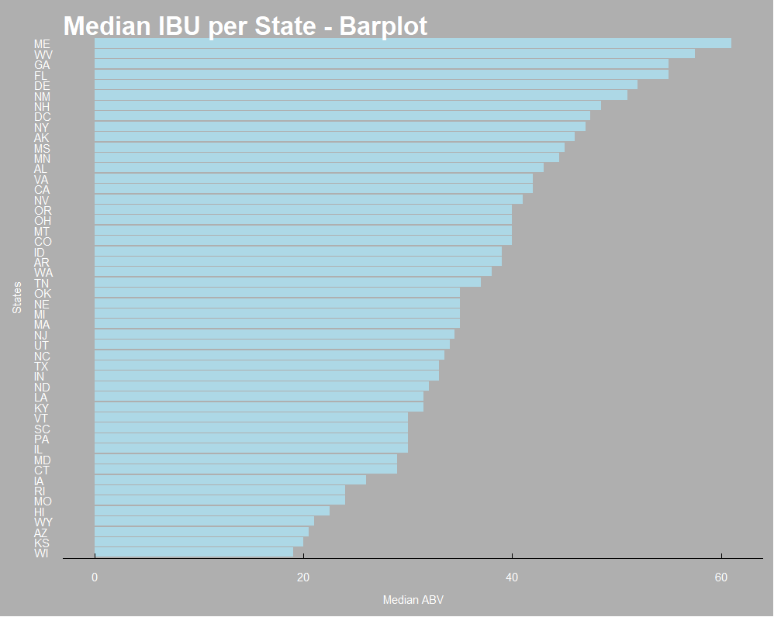

Slide 6
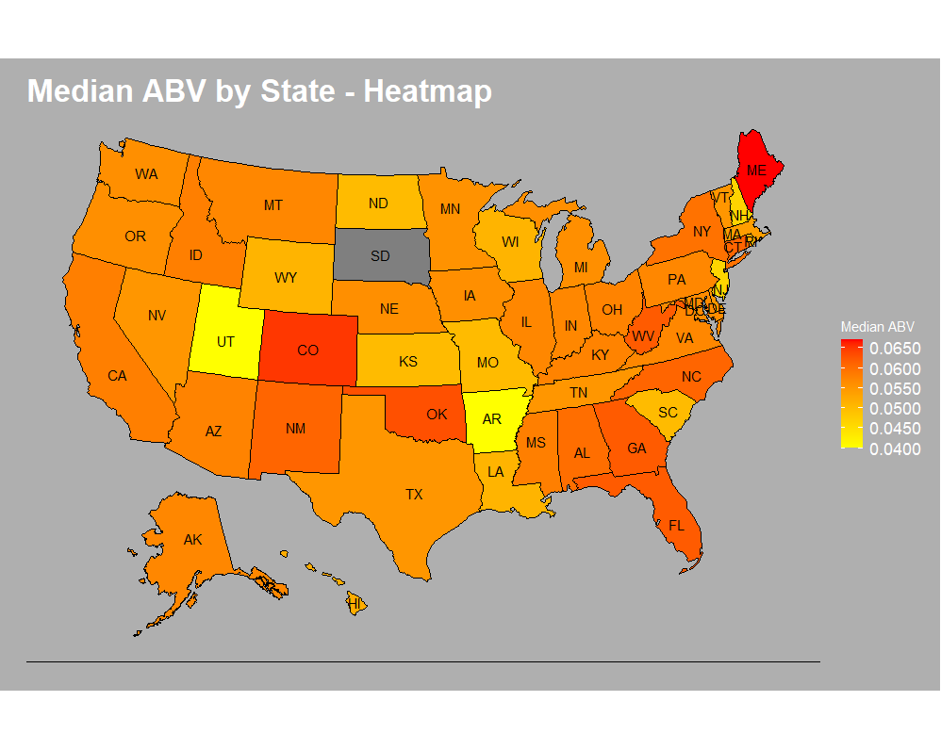

Slide 7
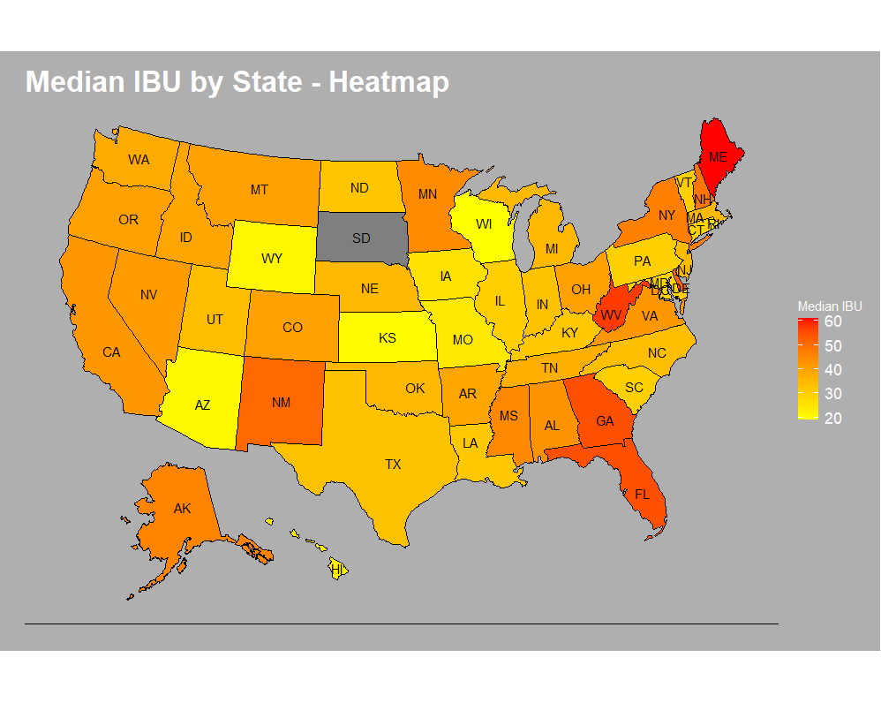

Slide 8
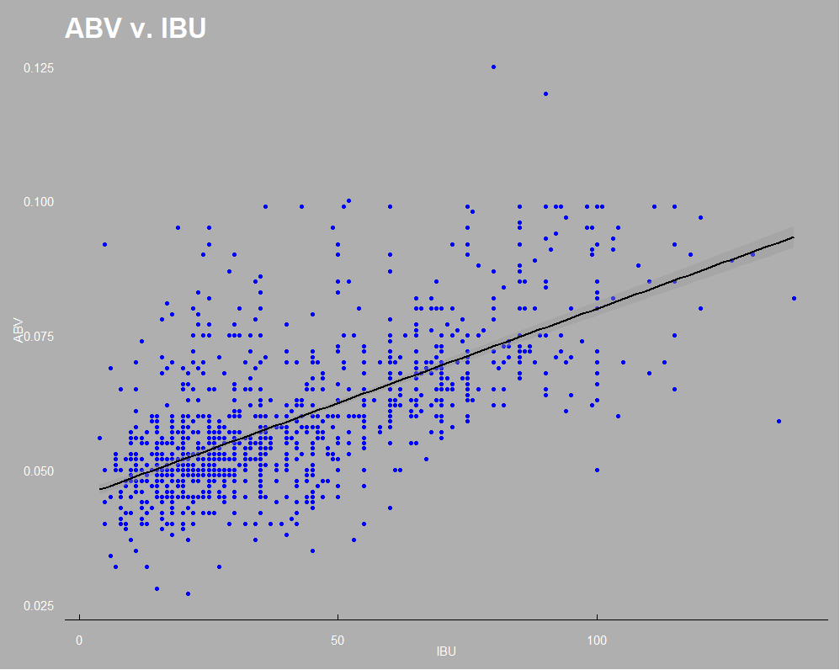

Slide 9
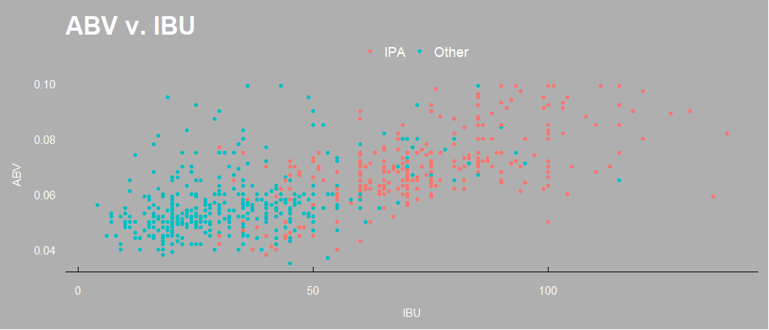
The Model
IPAs are a distinct type of Ale.
KNN model:
Accuracy: 92%
Sensitivity: 89%
Specificity: 94%
The model is able to detect IPA!

Slide 10
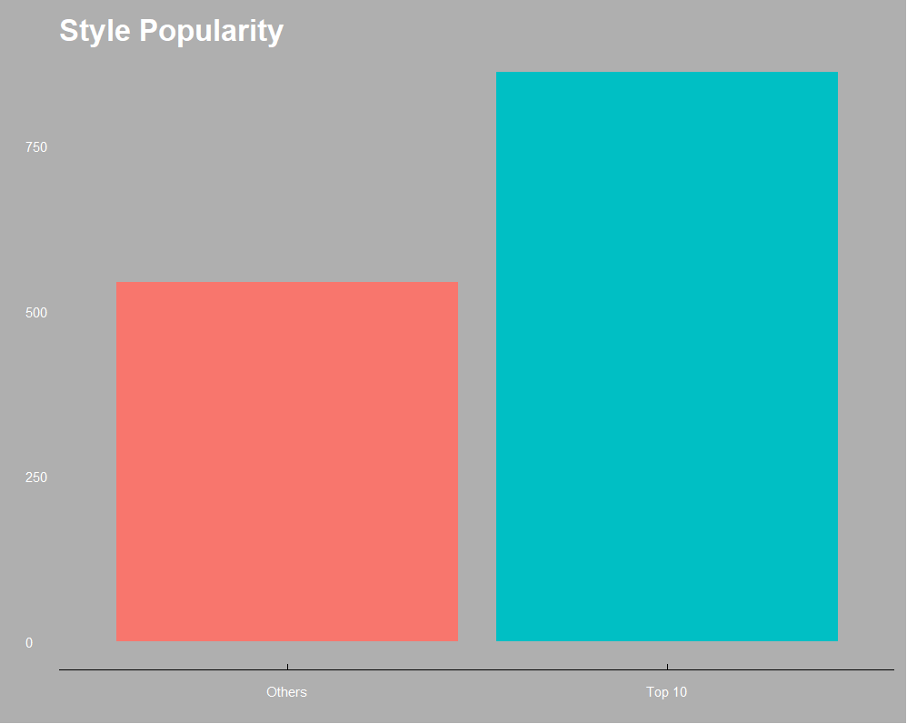
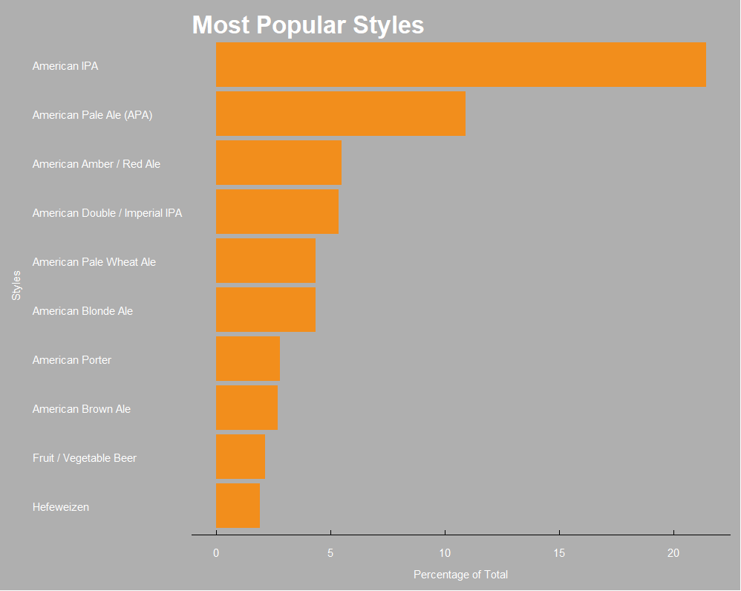
91 Different Styles

Slide 11
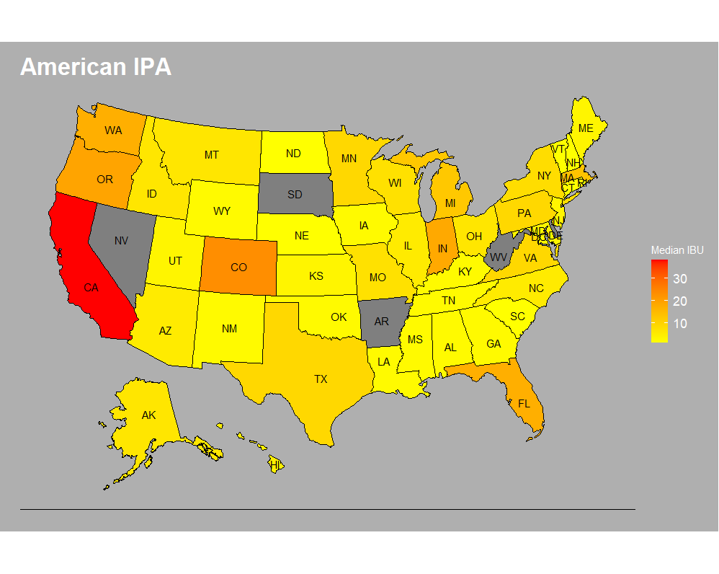
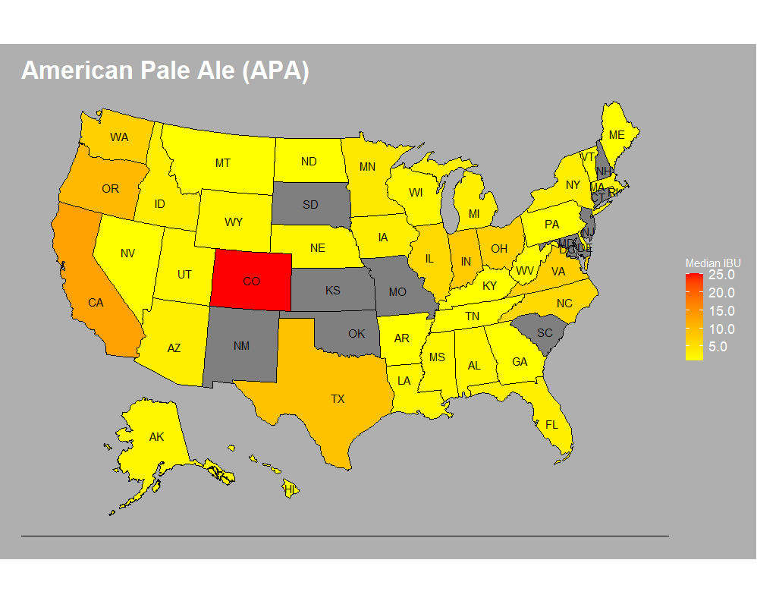
American IPA
American Pale Ale (APA)

